Slide 1
Integrity constraints
Integrity constraints are a set of rules. It is used to maintain the quality of information.
Integrity constraints ensure that the data insertion, updating, and other processes have to be performed in such a way that data integrity is not affected.

Slide 2
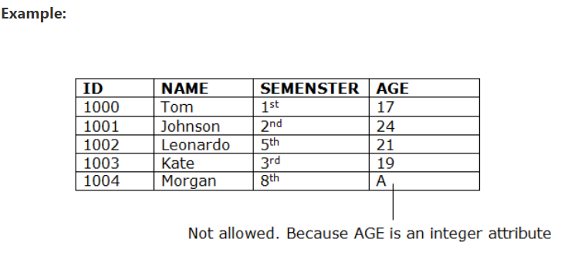
Types of integrity constraints
1. Domain constraints
Domain constraints can be defined as the definition of a valid set of values for an attribute.
Like phone number should be of 10 digits ,age is integer.

Slide 3
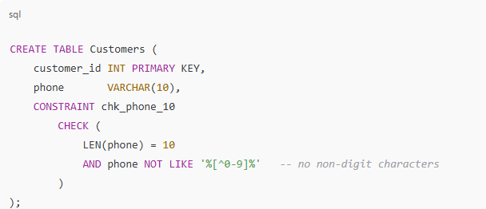
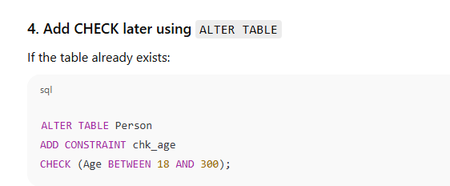
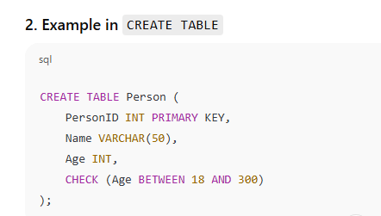
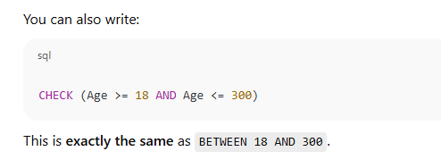

Slide 4
2. Entity integrity constraints
The entity integrity constraint states that primary key value can't be null.
This is because the primary key value is used to identify individual rows in relation and if the primary key has a null value, then we can't identify those rows.
A table can contain a null value other than the primary key field.

Slide 5
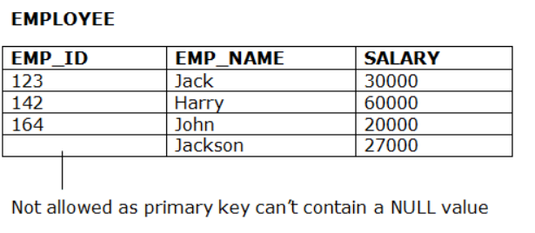

Slide 6
3. Referential Integrity Constraints
A referential integrity constraint is specified between two tables.
In the Referential integrity constraints, if a foreign key in Table 1 refers to the Primary Key of Table 2, then every value of the Foreign Key in Table 1 must be null or be available in Table 2.

Slide 7
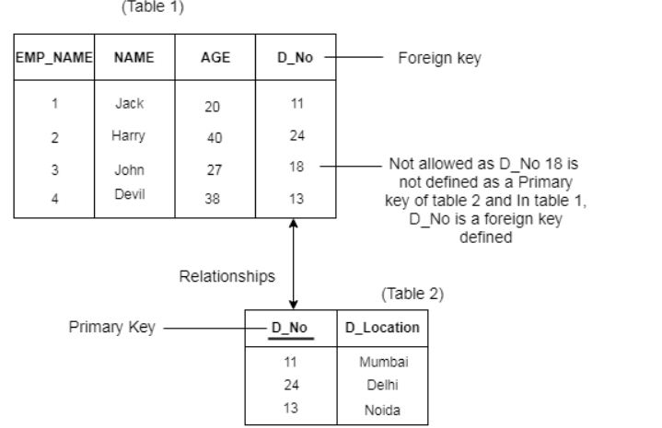

Slide 8
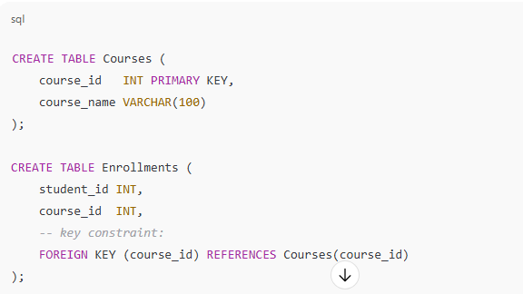

Slide 9
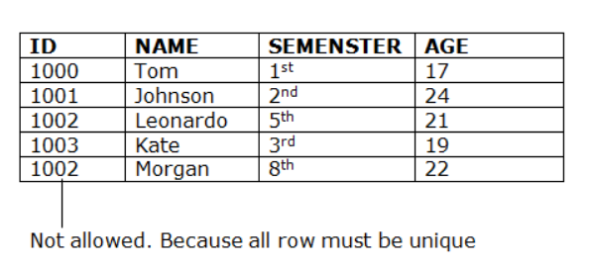
4. Key constraints
An table can have multiple keys, but out of which one key will be the primary key. A primary key can contain a unique value in the relational table.

Slide 10
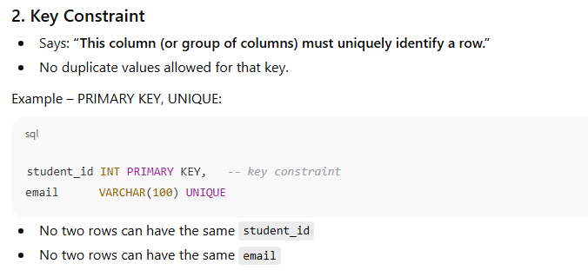

Slide 11
CREATE TABLE Persons (
ID int NOT NULL PRIMARY KEY,
LastName varchar(255) NOT NULL,
FirstName varchar(255),
Age int
);

Slide 12
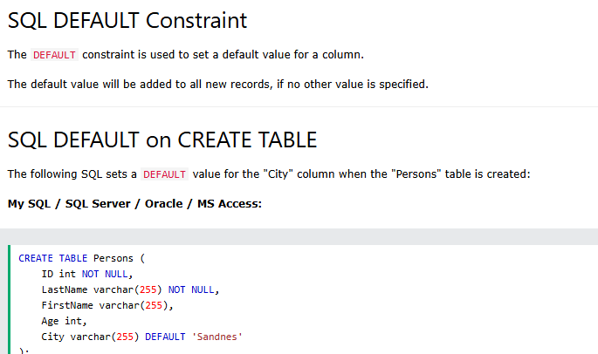

Slide 13
Sql queries
Chapter 4

Slide 14
What is SQL?
SQL stands for Structured Query Language.
SQL lets you access and manipulate databases.
SQL became a standard of the American National Standards Institute (ANSI) in 1986, and of the International Organization for Standardization (ISO) in 1987.

Slide 15
What Can SQL do?
SQL can execute queries against a database
SQL can retrieve data from a database
SQL can insert records in a database
SQL can update records in a database
SQL can delete records from a database
SQL can create new databases
SQL can create new tables in a database
SQL can create stored procedures in a database
SQL can create views in a database
SQL can set permissions on tables, procedures, and views

Slide 16
The SQL CREATE TABLE Statement
The CREATE TABLE statement is used to create a new table in a database.
CREATE TABLE Persons (
PersonID int primary key,
LastName varchar(255),
FirstName varchar(255) not null,
Address varchar(255),
City varchar(255)
);

Slide 17
SQL Constraints
SQL constraints are used to specify rules for the data in a table.
NOT NULL - Ensures that a column cannot have a NULL value
UNIQUE - Ensures that all values in a column are different
PRIMARY KEY - A combination of a NOT NULL and UNIQUE. Uniquely identifies each row in a table
FOREIGN KEY - Prevents actions that would destroy links between tables
CHECK - Ensures that the values in a column satisfies a specific condition
DEFAULT - Sets a default value for a column if no value is specified

Slide 18
CREATE TABLE Orders (
OrderID int NOT NULL,
OrderNumber int NOT NULL,
PersonID int,
PRIMARY KEY (OrderID),
FOREIGN KEY (PersonID) REFERENCES Persons(PersonID)
);

Slide 19
The SQL DROP TABLE Statement
The DROP TABLE statement is used to drop an existing table in a database.
SQL TRUNCATE TABLE
The TRUNCATE TABLE statement is used to delete the data inside a table, but not the table itself.

Slide 20
SQL Constraints
Constraints can be specified when the table is created with the CREATE TABLE statement
Syntax
CREATE TABLE table_name (
column1 datatype constraint,
column2 datatype constraint,
column3 datatype constraint,
....
);

Slide 21
SQL ALTER TABLE Statement
The ALTER TABLE statement is used to add, delete in an existing table.
ALTER TABLE Customers
ADD Email varchar(255);
ALTER TABLE Customers
DROP COLUMN Email;

Slide 22
The SQL SELECT Statement
The SELECT statement is used to select data from a database.
The data returned is stored in a result table, called the result-set.

Slide 23
SELECT DISTINCT Examples
The SELECT DISTINCT statement is used to return only distinct (different) values.
Inside a table, a column often contains many duplicate values and sometimes you only want to list the different (distinct) values.
SELECT DISTINCT Country FROM Customers;

Slide 24
The SQL WHERE Clause
The WHERE clause is used to filter records.
It is used to extract only those records that fulfill a specified condition.

Slide 25
The SQL AND, OR and NOT Operators
The WHERE clause can be combined with AND, OR, and NOT operators.
The AND and OR operators are used to filter records based on more than one condition:
The AND operator displays a record if all the conditions separated by AND are TRUE.
The OR operator displays a record if any of the conditions separated by OR is TRUE.
The NOT operator displays a record if the condition(s) is NOT TRUE.

Slide 26
SELECT * FROM Customers
WHERE Country='Germany' AND City='Berlin';
SELECT * FROM Customers
WHERE City='Berlin' OR City='München';
SELECT * FROM Customers
WHERE NOT Country='Germany';
SELECT * FROM PERSON WHERE NOT NAME =‘ram’;

Slide 27
What is a NULL Value?
A field with a NULL value is a field with no value.
SELECT column_names
FROM table_name
WHERE column_name IS NULL;
SELECT CustomerName, ContactName, Address
FROM Customers
WHERE Address IS NULL;

Slide 28
The SQL INSERT INTO Statement
The INSERT INTO statement is used to insert new records in a table.
INSERT INTO Syntax
It is possible to write the INSERT INTO statement in two ways:
1. Specify both the column names and the values to be inserted:

Slide 29
The SQL UPDATE Statement
syntax
UPDATE table_name
SET column1 = value1, column2 = value2, ...
WHERE condition;
UPDATE Customers
SET ContactName = 'Alfred Schmidt', City= 'Frankfurt'
WHERE CustomerID = 1;

Slide 30
The SQL DELETE Statement
The DELETE statement is used to delete existing records in a table.
DELETE FROM Customers WHERE Customerid=1;

Slide 31
Delete All Records
DELETE FROM table_name;
DELETE FROM Customers;

Slide 32
The SQL ORDER BY Keyword
The ORDER BY keyword is used to sort the result-set in ascending or descending order.
The ORDER BY keyword sorts the records in ascending order by default. To sort the records in descending order, use the DESC keyword.

Slide 33
SELECT * FROM Customers
ORDER BY Country;
SELECT * FROM Customers
ORDER BY Country DESC;

Slide 34
SQL MIN() and MAX() Functions
The MIN() function returns the smallest value of the selected column.
The MAX() function returns the largest value of the selected column.
SELECT MIN(column_name)
FROM table_name
WHERE condition;
SELECT MAX(column_name)
FROM table_name
WHERE condition;

Slide 35
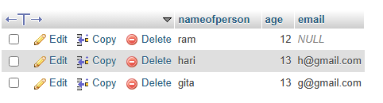
SELECT MIN(Price) AS SmallestPrice
FROM Products;
SELECT MAX(Price) AS LargestPrice
FROM Products;
select name as nameofperson,age,email from person ;

Slide 36
The SQL COUNT(), AVG() and SUM(),min(),max()
Aggregate function
The COUNT() function returns the number of rows that matches a specified criterion.
COUNT() Syntax
SELECT count(column_name)
FROM table_name
WHERE condition;
AVG() Syntax
SELECT AVG(column_name)
FROM table_name
WHERE condition;
The AVG() function returns the average value of a numeric column.

Slide 37


SELECT COUNT(ProductID)
FROM Products;
SELECT AVG(Price)
FROM Products;

Slide 38
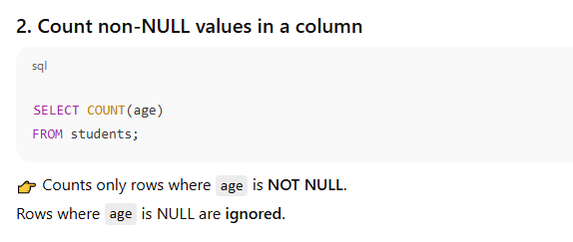
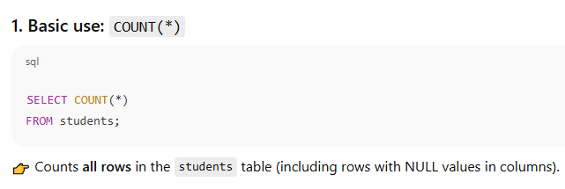
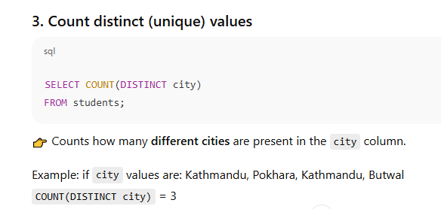

Slide 40
SUM() Example
SELECT SUM(Quantity)
FROM OrderDetails;

Slide 41
The SQL LIKE Operator
The LIKE operator is used in a WHERE clause to search for a specified pattern in a column.
There are two wildcards often used in conjunction with the LIKE operator:
The percent sign (%) represents zero, one, or multiple characters
The underscore sign (_) represents one, single character
Example.
SELECT * FROM Customers
WHERE CustomerName LIKE 'a%';

Slide 42
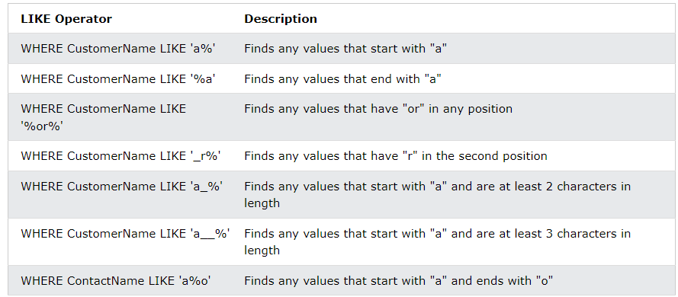

Slide 43
The IN operator allows you to specify multiple values in a WHERE clause.
The SQL IN Operator
SELECT * FROM Customers
WHERE Country IN ('Germany', 'France', 'UK');
SELECT * FROM Customers
WHERE Country NOT IN ('Germany', 'France', 'UK');
SELECT * FROM Customers
WHERE Country IN (SELECT Country FROM Suppliers);

Slide 44
The SQL BETWEEN Operator
The BETWEEN operator selects values within a given range. The values can be numbers, text, or dates.
The BETWEEN operator is inclusive: begin and end values are included.
SELECT * FROM Products
WHERE Price BETWEEN 10 AND 20;

Slide 45
SQL Aliases
SQL aliases are used to give a table, or a column in a table, a temporary name.
Aliases are often used to make column names more readable.
An alias only exists for the duration of that query.
An alias is created with the AS keyword.
Alias Column Syntax
SELECT column_name AS alias_name
FROM table_name;
Alias for Columns Examples
SELECT CustomerID AS ID, CustomerName AS Customer
FROM Customers;

Slide 46
Alias for Tables Example
SELECT o.OrderID, o.OrderDate, c.CustomerName
FROM Customers AS c, Orders AS o
WHERE c.CustomerName='Around the Horn' AND c.CustomerID=o.CustomerID;

Slide 47
The SQL GROUP BY Statement
The GROUP BY statement groups rows that have the same values into summary rows, like "find the number of customers in each country".

Slide 48
The SQL HAVING Clause
The HAVING clause was added to SQL because the WHERE keyword cannot be used with aggregate functions.

Slide 49
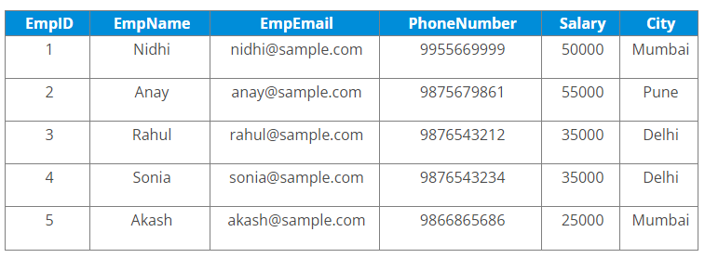
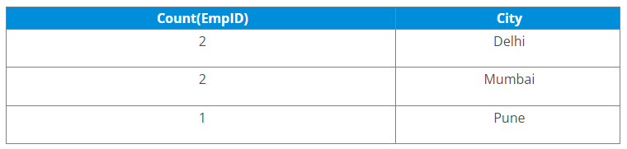
Employees table
SELECT COUNT(EmpID), City
FROM Employees
GROUP BY City;

Slide 50
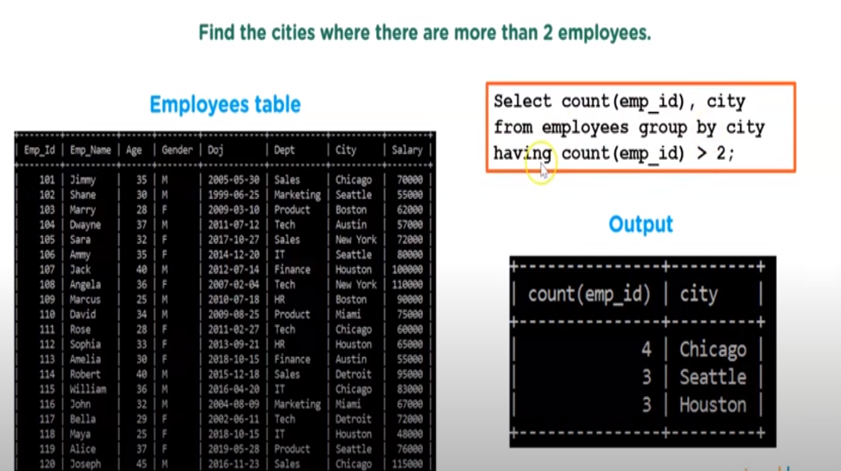

Slide 51
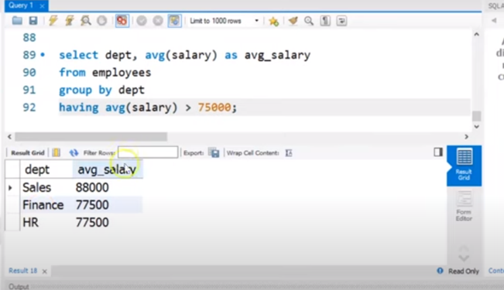

Slide 52
Sql subquery
A Subquery or Inner query or a Nested query is a query within another SQL query and embedded within the WHERE clause.
A subquery is used to return data that will be used in the main query as a condition to further restrict the data to be retrieved.
example
SELECT * FROM employees WHERE employee_id IN (SELECT employee_id FROM employees WHERE SALARY > 17000) ;

Slide 53
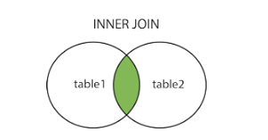
SQL INNER JOIN KEYWORD
The INNER JOIN keyword selects records that have matching values in both tables.
INNER JOIN Syntax
SELECT column_name(s)
FROM table1
INNER JOIN table2
ON table1.column_name = table2.column_name;
SELECT Orders.OrderID, Customers.CustomerName
FROM Orders
INNER JOIN Customers ON Orders.CustomerID = Customers.CustomerID;

Slide 54
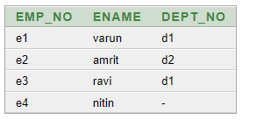
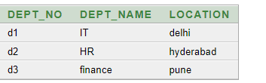

Inner join
employee
department
select emp_no , ename , dept_name , location from employee
Inner join department on employee.dept_no = department.dept_no ;

Slide 55
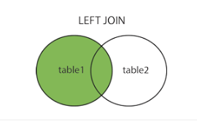
SQL LEFT JOIN Keyword
The LEFT JOIN keyword returns all records from the left table (table1), and the matching records from the right table (table2). The result is 0 records from the right side, if there is no match.
LEFT JOIN Syntax
SELECT column_name(s)
FROM table1
LEFT JOIN table2
ON table1.column_name = table2.column_name;
SELECT Customers.CustomerName, Orders.OrderID
FROM Customers
LEFT JOIN Orders ON Customers.CustomerID = Orders.CustomerID
ORDER BY Customers.CustomerName;

Slide 56
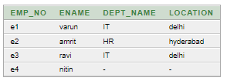
Left join
employee
department
select emp_no ,ename,dept_name,location from employee
left join department on employee.dept_no = department.dept_no order by emp_no;

Slide 57
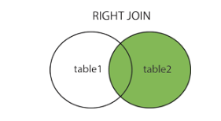
SQL RIGHT JOIN Keyword
The RIGHT JOIN keyword returns all records from the right table (table2), and the matching records from the left table (table1). The result is 0 records from the left side, if there is no match.
RIGHT JOIN Syntax
SELECT column_name(s)
FROM table1
RIGHT JOIN table2
ON table1.column_name = table2.column_name;
SELECT Orders.OrderID, Employees.LastName, Employees.FirstName
FROM Orders
RIGHT JOIN Employees ON Orders.EmployeeID = Employees.EmployeeID
ORDER BY Orders.OrderID;

Slide 58

RIGHT JOIN
Employee
department
select emp_no ,ename,department.dept_name,location from employee
right join
department on employee.dept_no = department.dept_no order by emp_no;

Slide 59
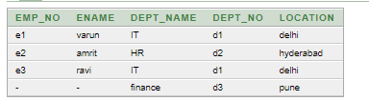
Right join with writing dept_no column
Employee
department
select emp_no ,ename,dept_name,department.dept_no,location from employee
right join
department on employee.dept_no = department.dept_no order by emp_no;

Slide 60
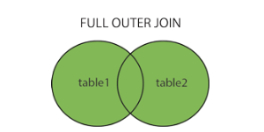
SQL FULL OUTER JOIN Keyword
The FULL OUTER JOIN keyword returns all records when there is a match in left (table1) or right (table2) table records.
Tip: FULL OUTER JOIN and FULL JOIN are the same.
FULL OUTER JOIN Syntax
SELECT column_name(s)
FROM table1
FULL OUTER JOIN table2
ON table1.column_name = table2.column_name
WHERE condition;

Slide 61
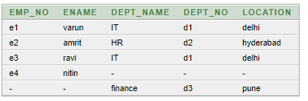
Full join
Employee
department
select emp_no ,ename,dept_name,department.dept_no,location from employee
Full join
department on employee.dept_no = department.dept_no order by emp_no;

Slide 62
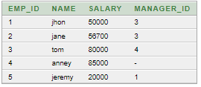

Self join query
A self join is a regular join, but the table is joined with itself.
Emp_tbl

Slide 63
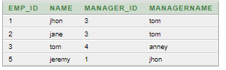
Self join
employee
manager
SELECT employee.emp_id,employee.name,employee.Manager_id,manager.name as managername
FROM emp_tbl employee
JOIN emp_tbl manager
ON employee.manager_id = manager.emp_id order by emp_id;

Slide 64
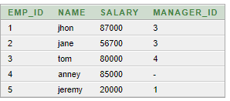

find employees whose salary is greater than their managers salary.[self join]
;

Slide 65
emp
manager
select emp.emp_id,emp.name,emp.salary,emp.manager_id,manager.name,manager.salary from emp_tbl emp inner join emp_tbl manager
on emp.manager_id = manager.emp_id
where emp.salary >manager.salary;

Slide 66
find employees whose salary is greater than their managers salary.[self join]
select emp.emp_id,emp.name,emp.salary,emp.manager_id,manager.name,manager.salary from emp_tbl emp inner join emp_tbl manager
on emp.manager_id = manager.emp_id
where emp.salary >manager.salary;

Slide 67
Q2.Update salary by 10% for employee_id =100

Slide 68
update employees set salary = salary*1.1 where employee_id = 100;
update employees set salary = salary * 1.1;

Slide 69
Q.1 Consider the following database
Student(sid,name,age)
Has(sid,cid)
College(cid,cname)
Write sql queries to perform the following
i)Find average age of student
ii)Display name of student who studies in dav college
iii)Insert a new student
iv)Display name of students whose name begin from ‘s’.
v)Delete record of ‘nast’ college from college relation.

Slide 70
Student(sid,name,age)
Has(sid,cid)
College(cid,cname)
Write sql queries to perform the following
i)Find average age of student
ii)Display name of student who studies in dav college
iii)Insert a new student
iv)Display name of students whose name begin from ‘s’.
v)Delete record of ‘nast’ college from college relation.
i.Select avg(age) as average_age from student;
Favg(salary)(student)
ii. select student.sid,student.name,college.cname from student
inner join has on student.sid = has.sid
inner join college on has.cid = college.cid where cname= 'dav';
iii.Insert into student (sid,name,age) values(2,’ram’,16);
iv.Select name from student where name like ‘s%’;
v.Delete from college where cname =‘nast’;

Slide 71
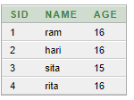




student
has
college
select student.sid,student.name,college.cname from student
inner join has on student.sid = has.sid
inner join college on has.cid = college.cid;
select student.sid,student.name,college.cname from student
inner join has on student.sid = has.sid
inner join college on has.cid = college.cid where cname = 'dav';

Slide 72
Cross join
A cross join is a join operation that produces the Cartesian product of two or more tables.

Slide 73
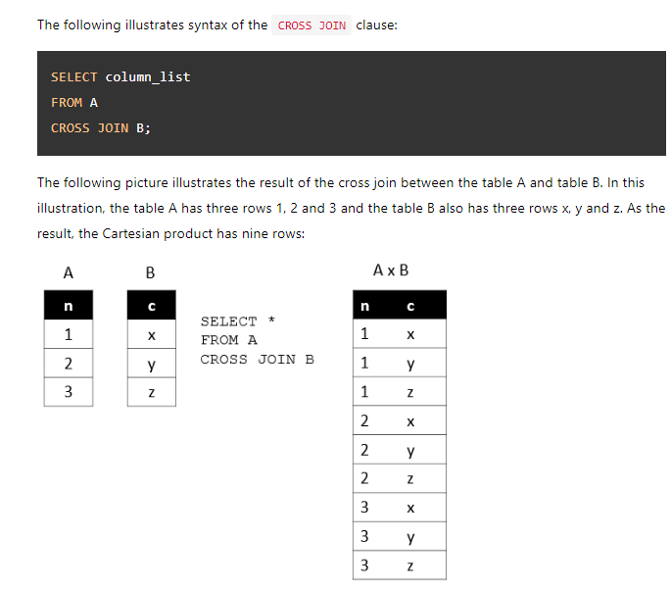

Slide 74
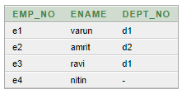

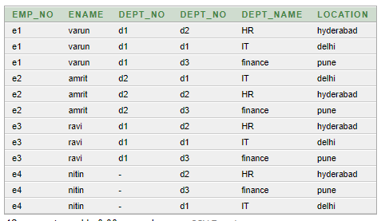
select * from employee
cross join
department order by emp_no;

Slide 75
Consider the following database schema
Employee(empname,street,city)
Works(empname,cmpname,salary)
Company(cmpname,city)
Manages(empname,cmpname)
1.Modify the database so that Amrit now lives in Naxal.
2.Delete all the tuples in the works relation for employee of XYZ corporation
3.Increase salary of all employee of ABC company by 10%.
4.Display all companyname located at city pokhara or Kathmandu from company details.
5.Display all employeename who have salary greater than 50000 from works table.

Slide 76
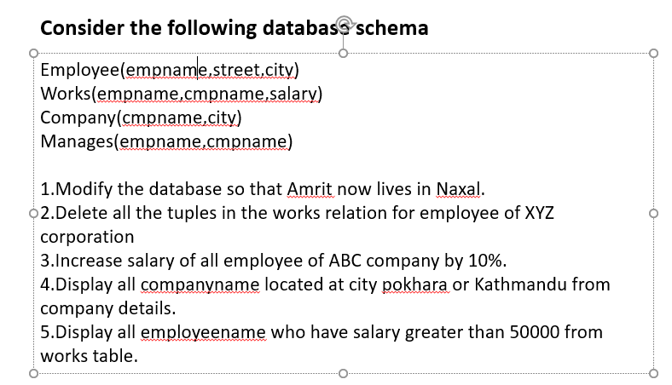
i.Update employee set street=‘naxal’ where empname =‘amrit’;
ii.Delete from works where cmpname =‘xyz’;
iii.Update employee set salary =salary * 1.1;
iv.Select cmpname ,city from company where city =‘pokhara’ or city=‘Kathmandu’;
v.Select empname from works where salary > 50000;

Slide 77
The SQL UNION Operator
The UNION operator is used to combine the result-set of two or more SELECT statement
Every SELECT statement within UNION must have the same number of columns
The columns must also have similar data types

Slide 78
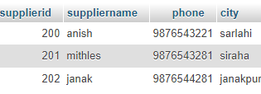
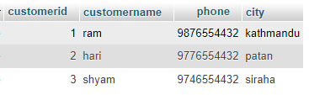

SELECT city FROM customer
UNION
SELECT city FROM supplier;

Slide 79
Intersect operator
The INTERSECT operator is a set operator that returns distinct rows of two or more result sets from SELECT statements.

Slide 80
SELECT city FROM customer
intersect
SELECT city FROM supplier;
siraha

Slide 81
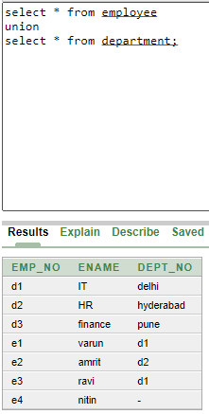

Slide 82
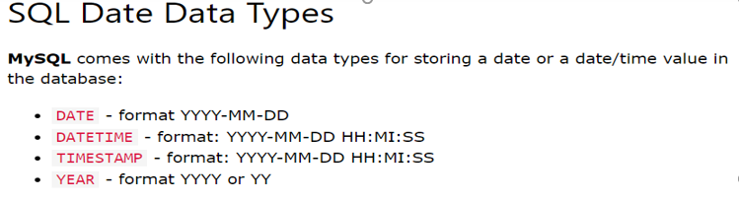

Slide 83
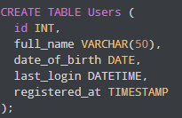

INSERT INTO Users VALUES (1, 'Harry Potter', '1999-04-14', '2022-04-22 10:34:53', '2020-03-15 07:31:42');

Slide 84
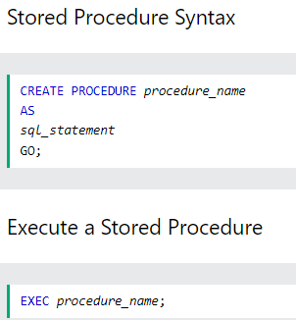
Stored procedure
A stored procedure is a prepared SQL code that you can save, so the code can be reused over and over again.
So if you have an SQL query that you write over and over again, save it as a stored procedure, and then just call it to execute it.

Slide 85
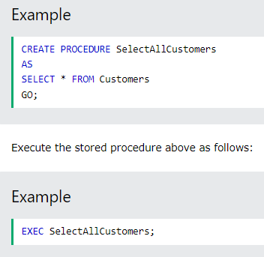

Slide 86
Query by example
It is a graphical query language where we get a user interface and then we fill some required fields to get our proper result.
In QBE we don’t write complete queries like SQL or other database languages it comes with some blank so we need to just fill that blanks and we will get our required result.

Slide 87
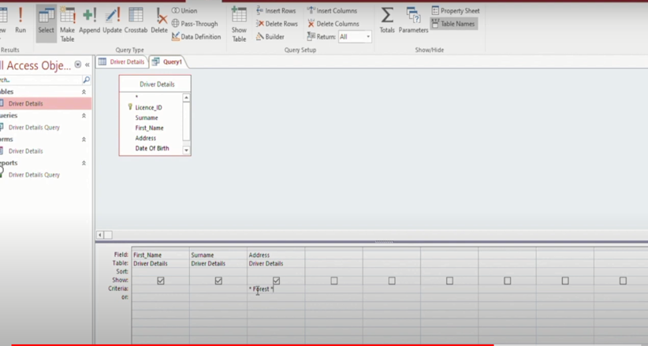

Slide 88
Presentation on following topics
Integrity constraints
Types of keys
Types of attributes
ER diagram of library management system,banking system,hospital management system,college management system
EF codd rules
Sql queries like,inner join,left join,full join,self join,right join
Roles of dba
Three schema architecture

Slide 89
insert into employeestable(hiredate) values(to_date('16-may-2021'));
select sysdate from dual;
SELECT EXTRACT(YEAR FROM sysdate) - EXTRACT(YEAR FROM hiredate) as duration FROM employeestable;
delete from employeestable where hiredate = '16-may-2023';

Slide 90
For practical
Read all the constraints like primary key,foreign key,not null,default ,check ,unique
employee
Employee_id | Ename | Joindate | Phoneno

